Slide 1
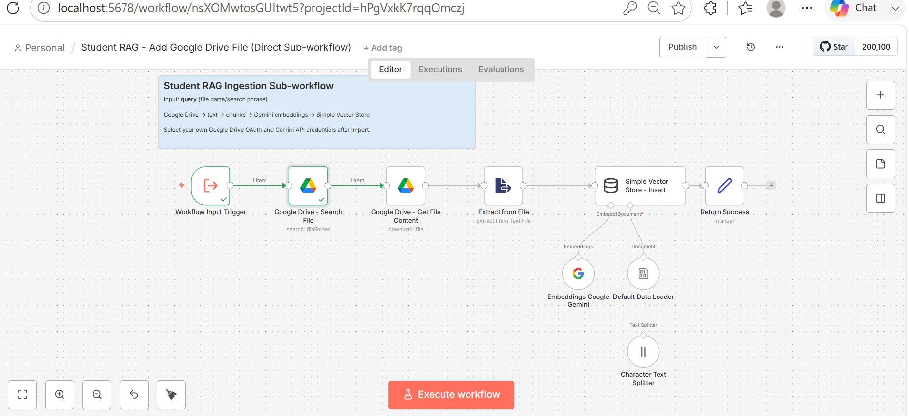

Slide 2
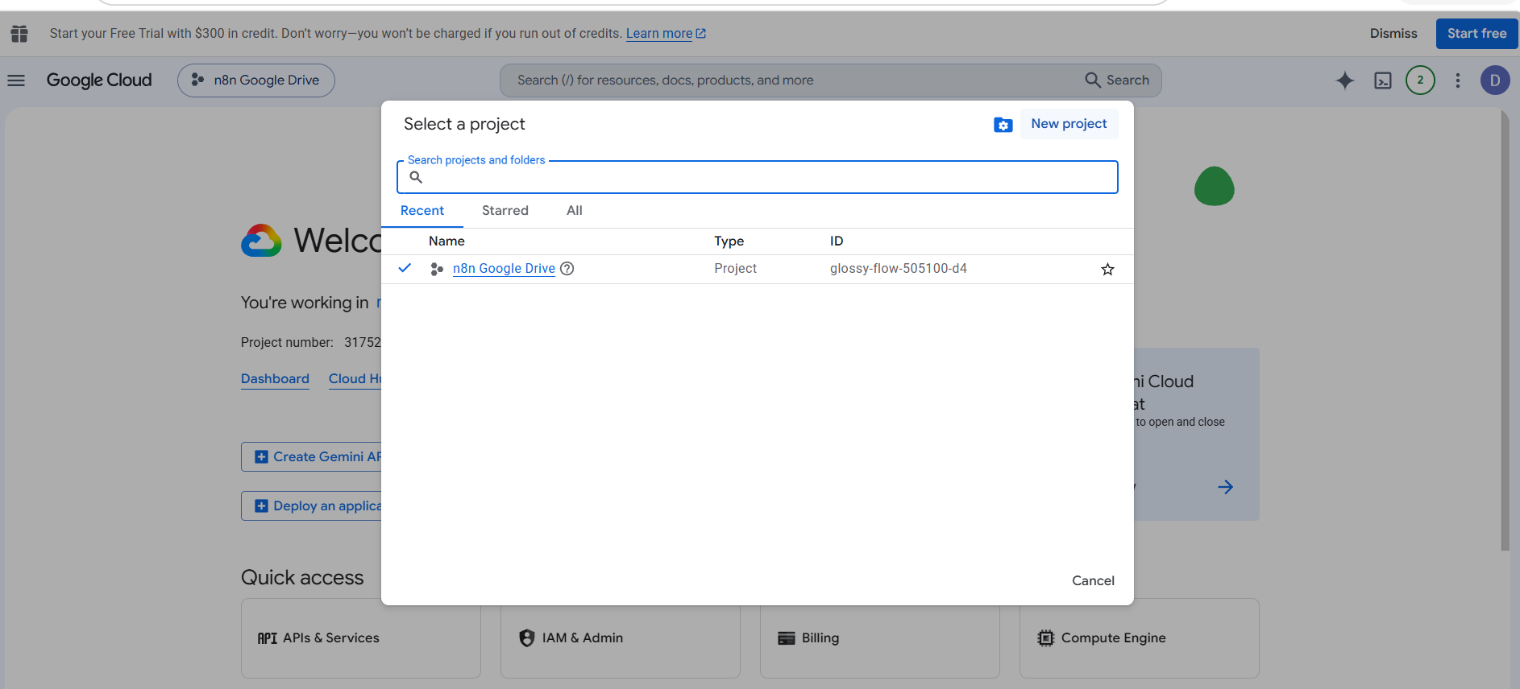

Slide 3
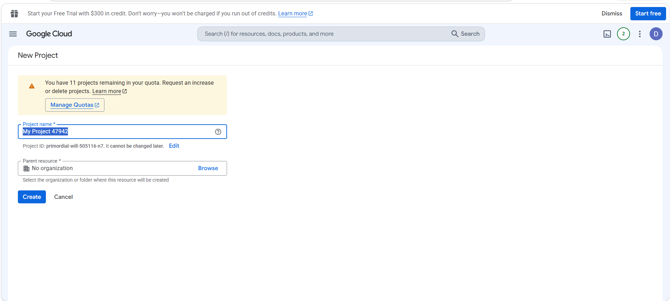

Slide 4
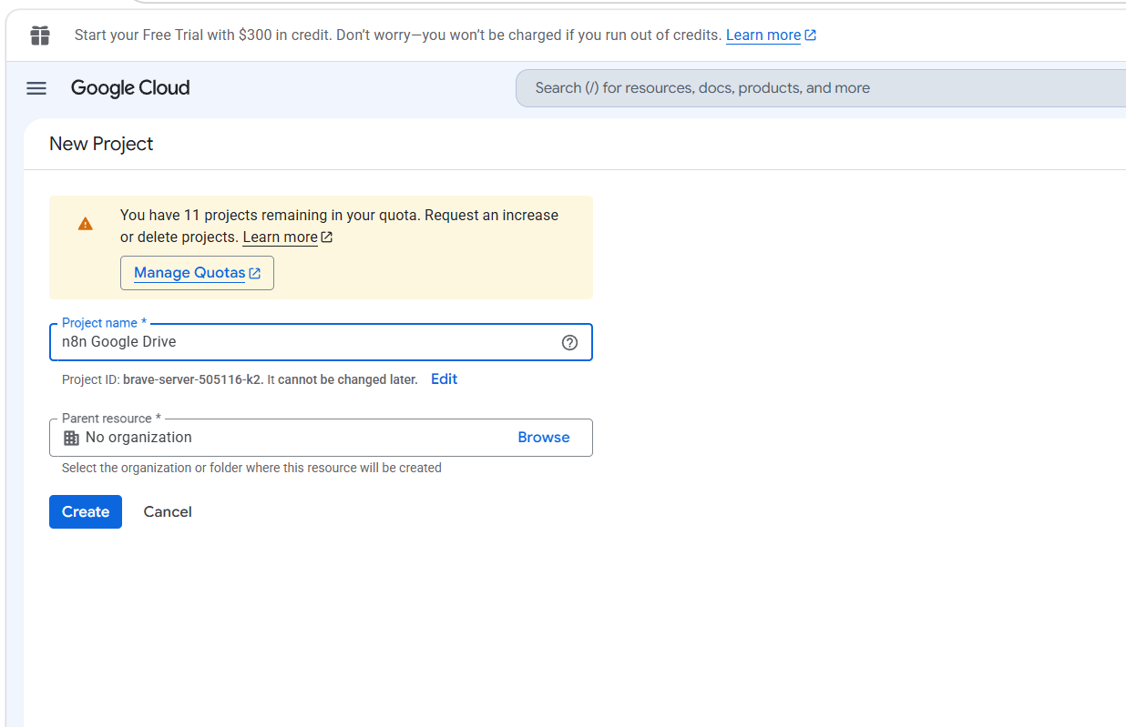

Slide 5
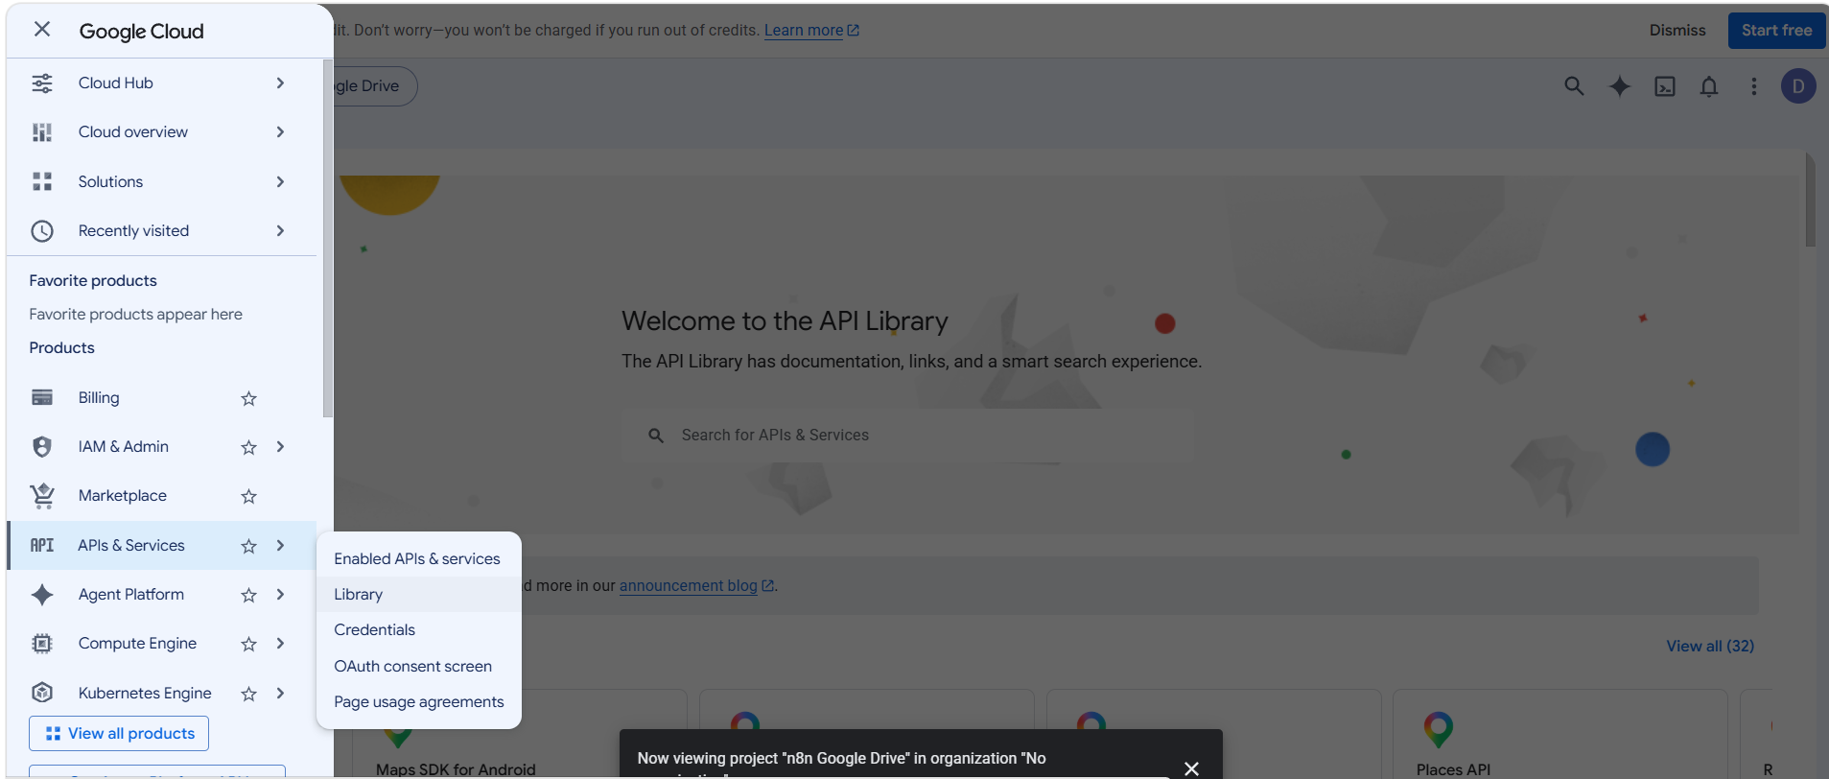

Slide 6
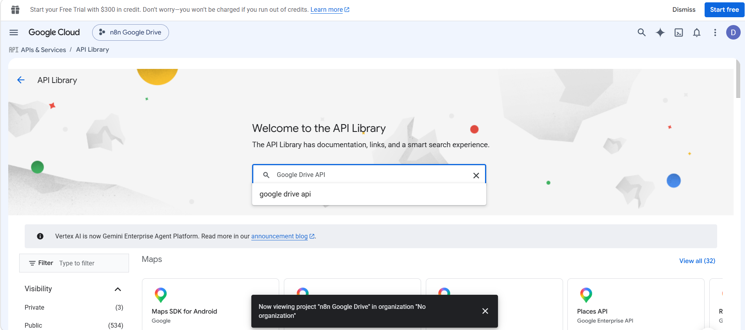

Slide 7
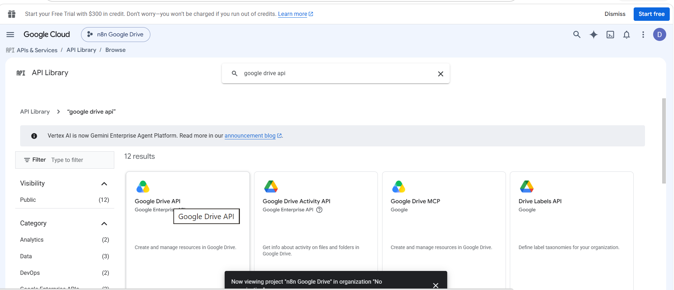

Slide 8
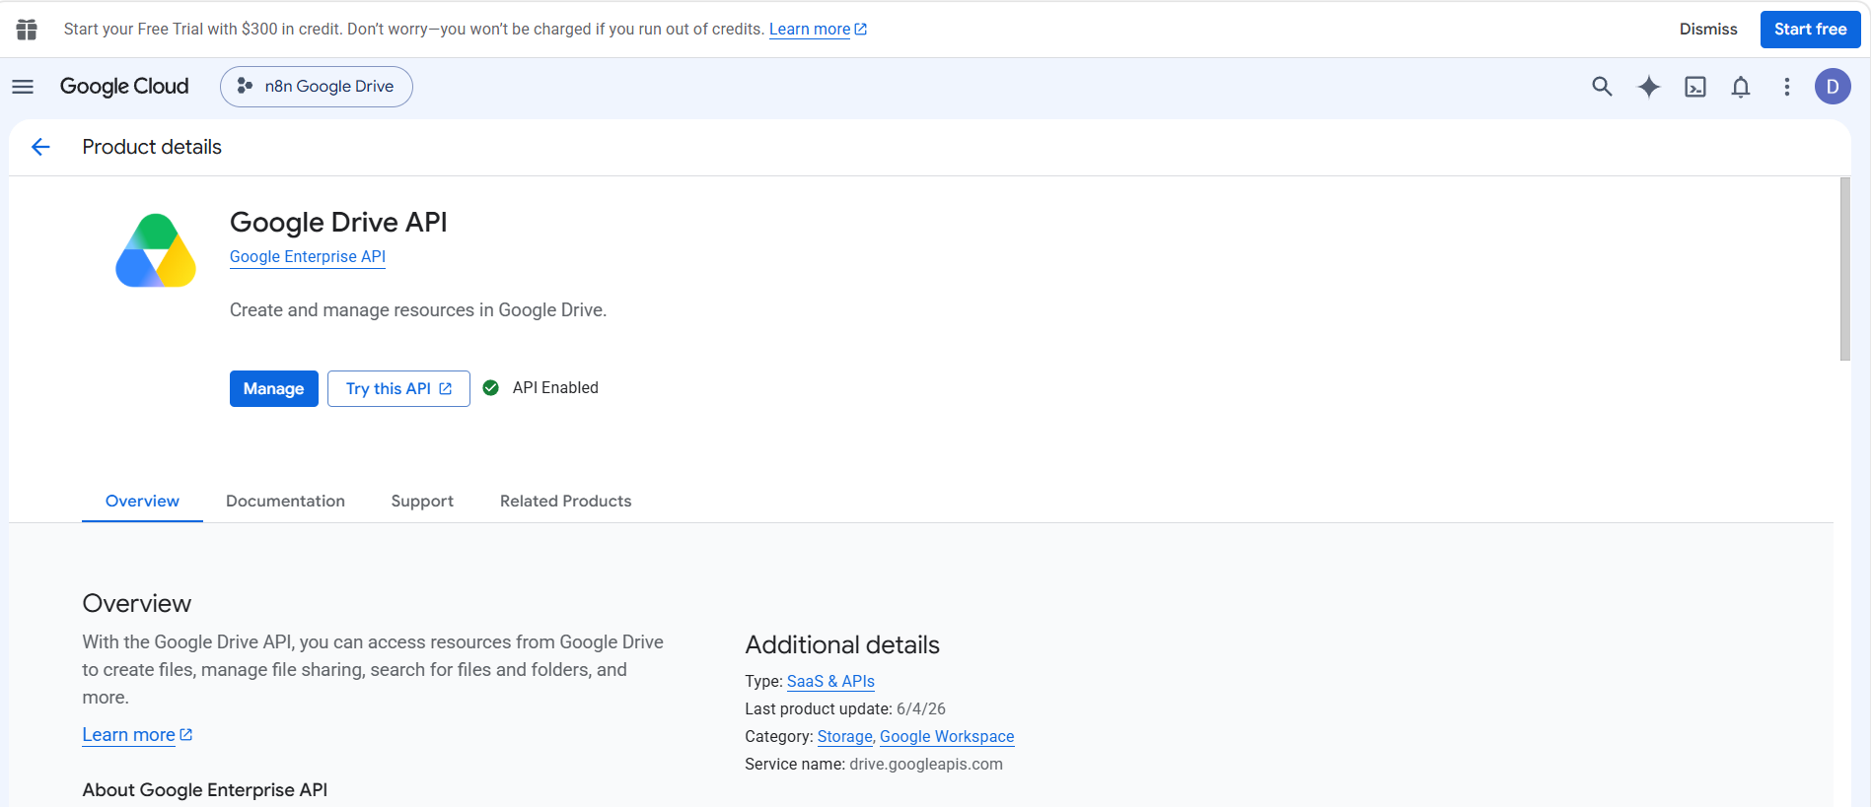

Slide 9
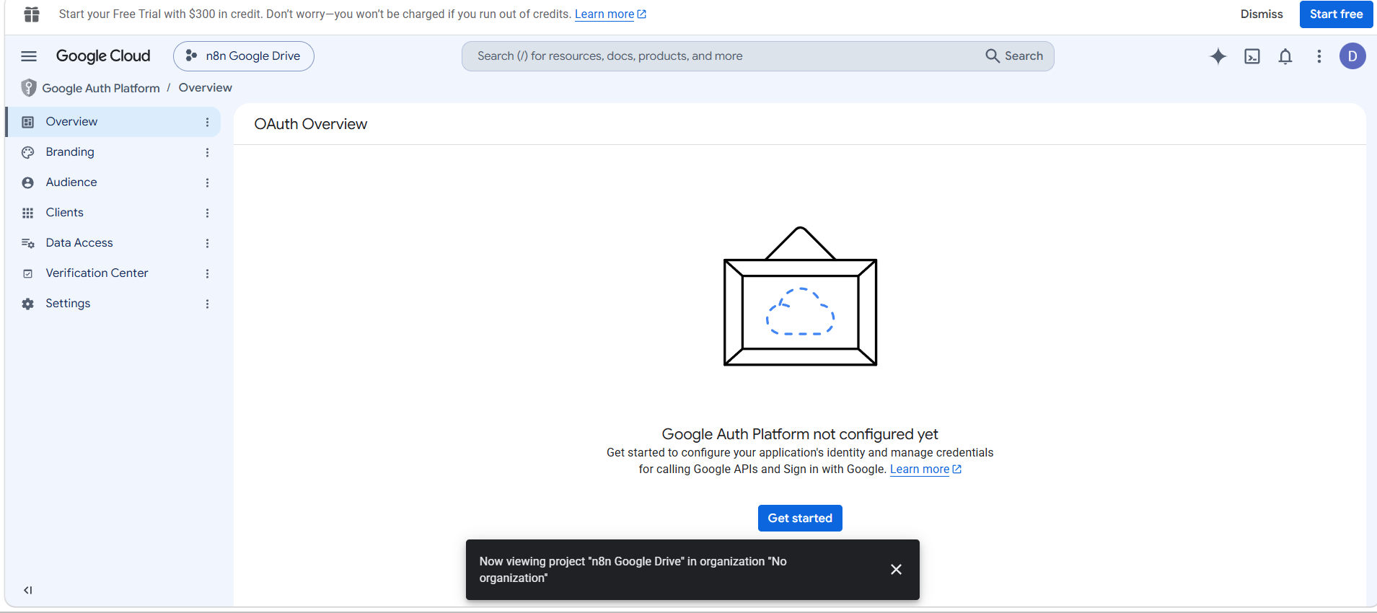

Slide 10
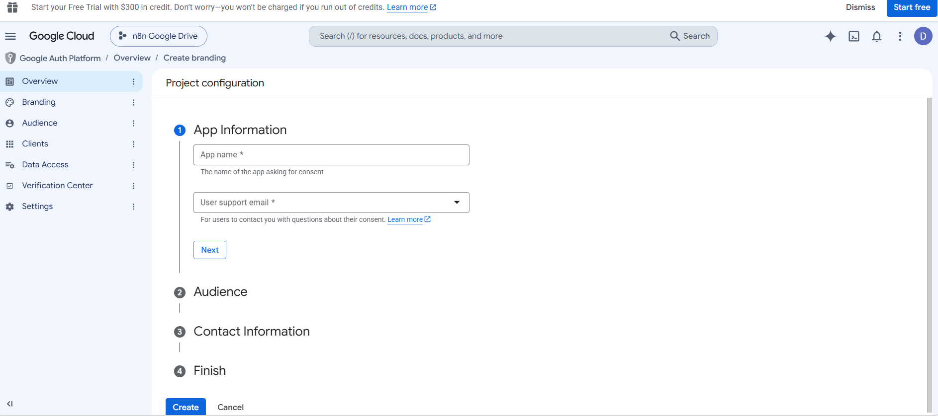

Slide 11
App name: n8n Google Drive
User support email: your Gmail account
Audience: choose External
Contact information: your Gmail account

Slide 12
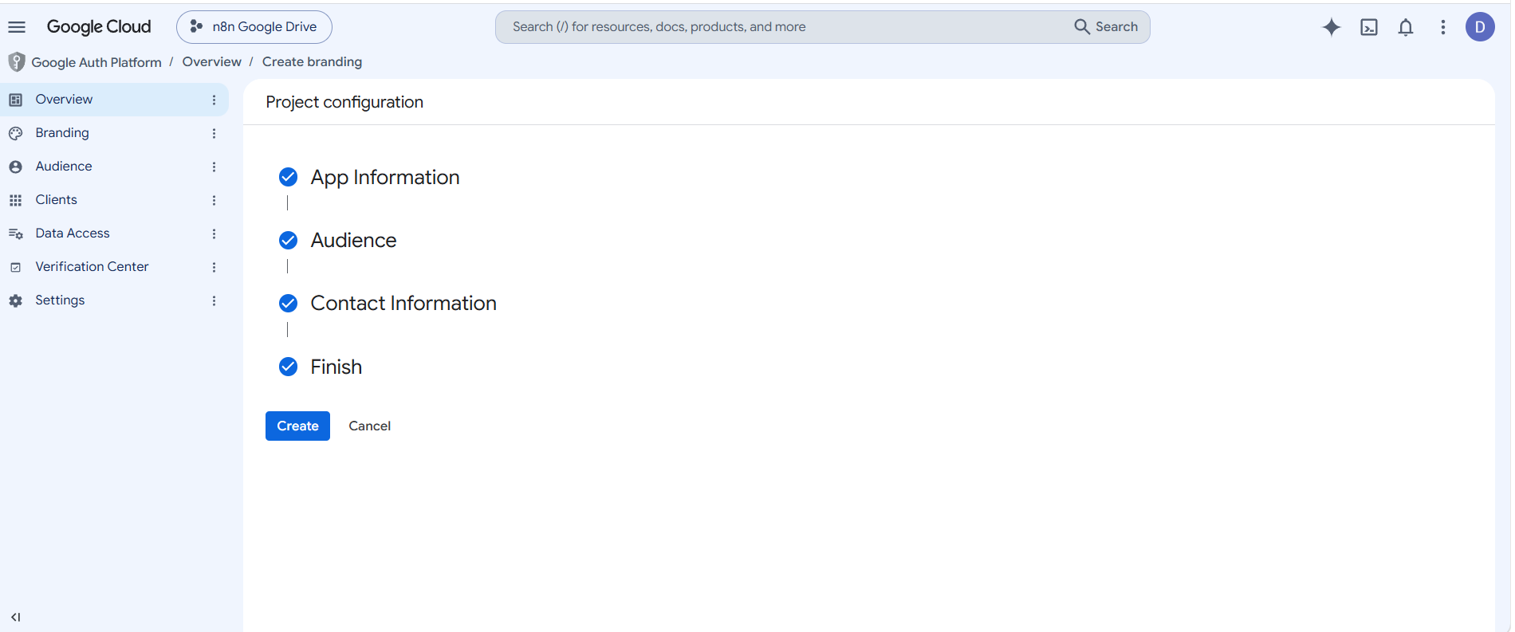

Slide 13
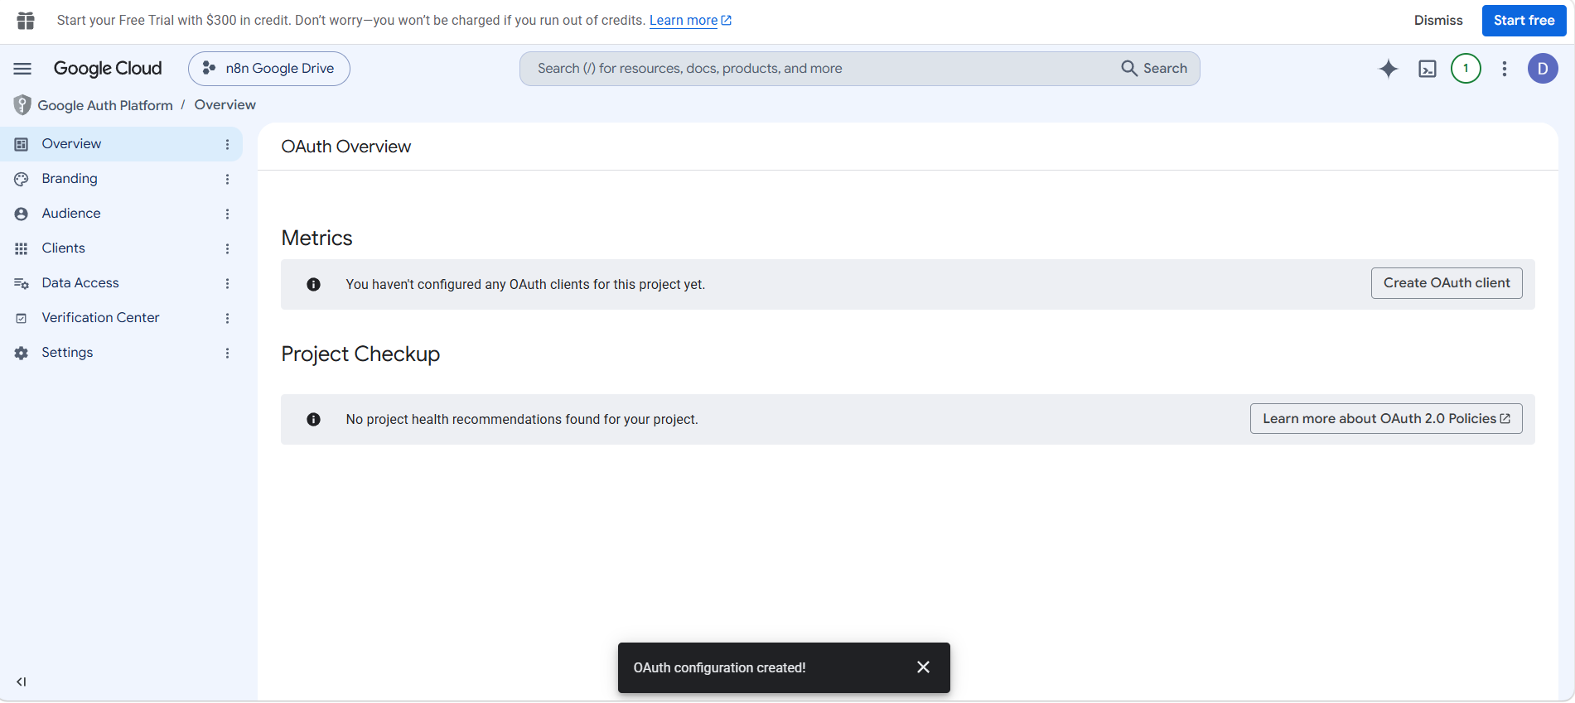

Slide 14
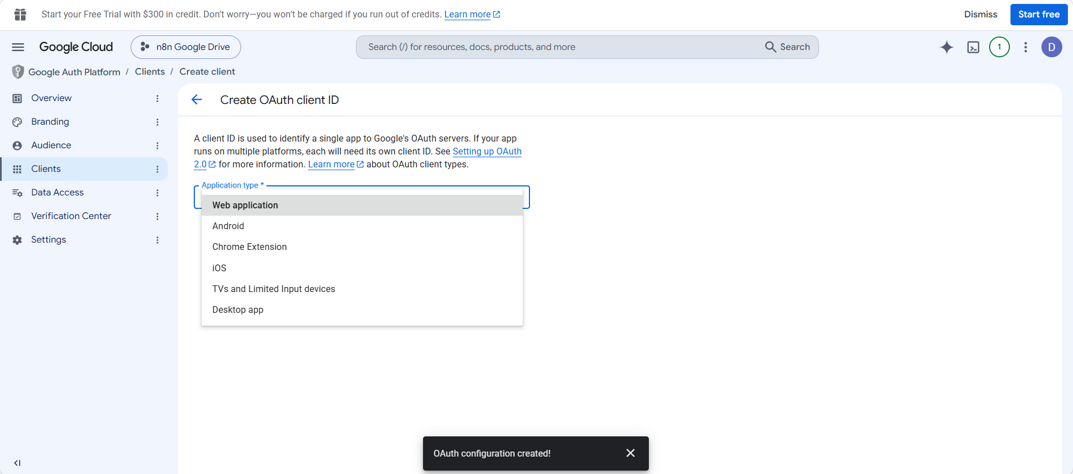

Slide 15
Keep Application type as Web application.
For Name, you can change Web client 1 to something clearer, such as n8n Google Drive Client.
Leave Authorized JavaScript origins completely empty. You don't need it for this n8n OAuth connection.
Scroll farther down until you see Authorized redirect URIs.
Click + Add URI.
Now do not guess the URI. Go back to n8n and open your Google Drive credential. At the top of that credential, n8n shows an OAuth Redirect URL. In your local installation it will likely be:
http://localhost:5678/rest/oauth2-credential/callback

Slide 16
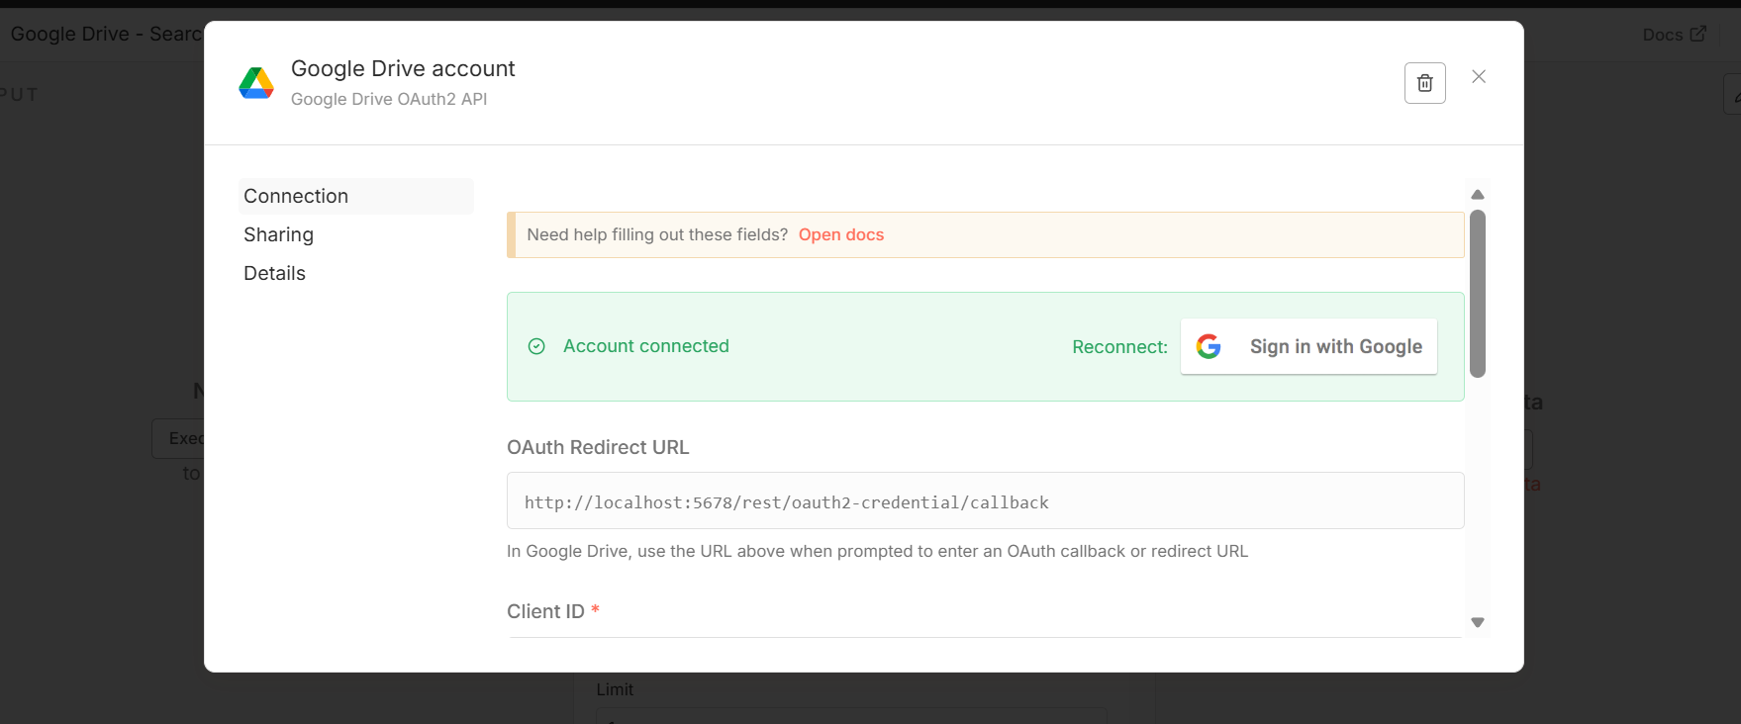

Slide 17
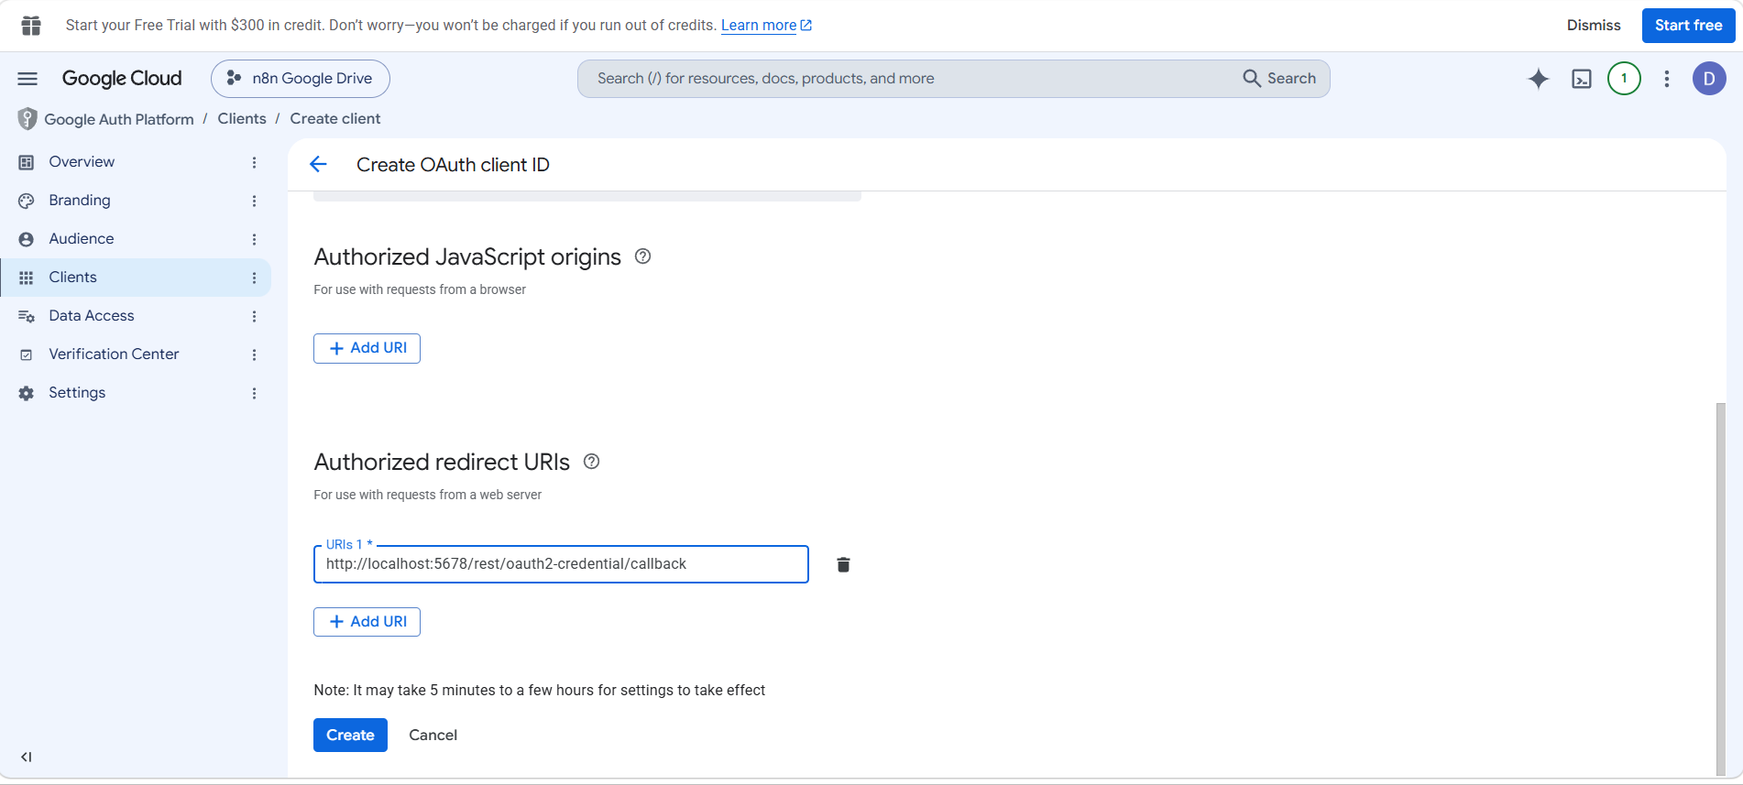

Slide 18
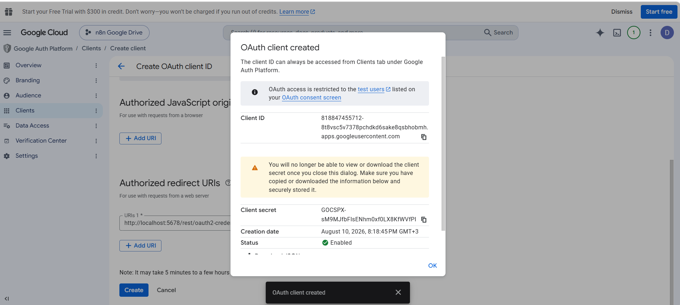

Slide 19
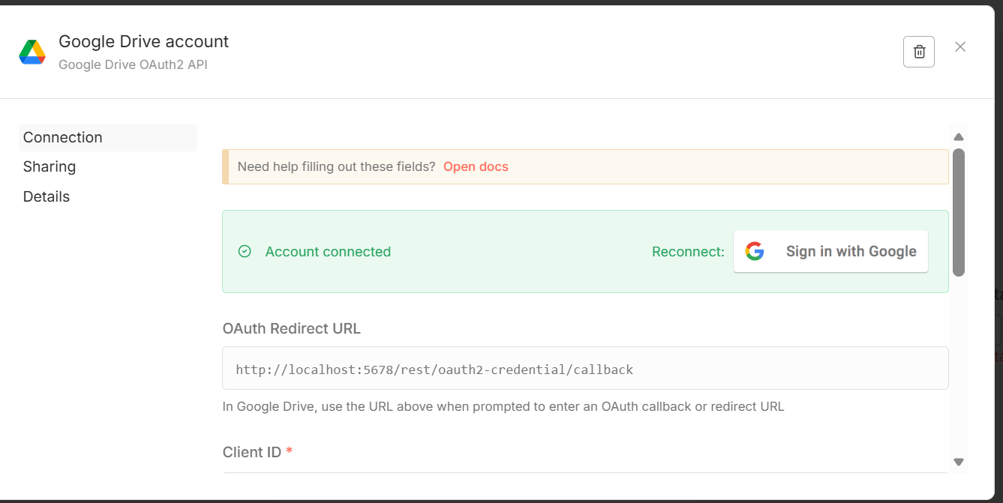
In n8n

Slide 20
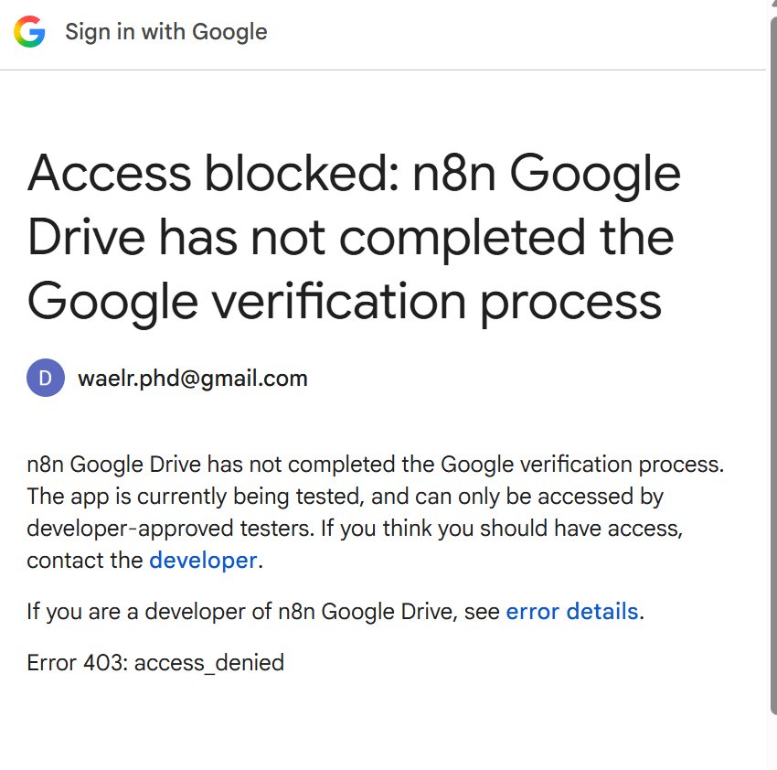

Slide 22
Go back to the same Google Cloud project you created for n8n:
Google Cloud Console → Google Auth Platform → Audience
On the Audience page, find the Test users section.
Then:
Click Add users.
Enter the exact Google account you're using to connect n8n — in your case, the Gmail account shown on this error screen.
Click Save.
Return to n8n.
Open Google Drive account → Sign in with Google again.
Sign in using the same Gmail account that you added as a Test User.
Accept the requested Google Drive permissions.
Then the OAuth callback returns to n8n and you should get:

Slide 23
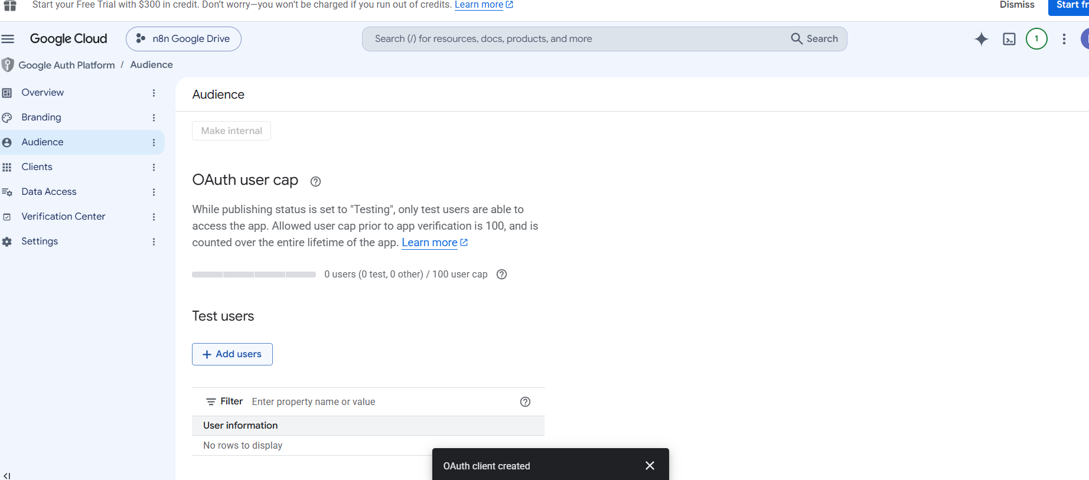

Slide 24
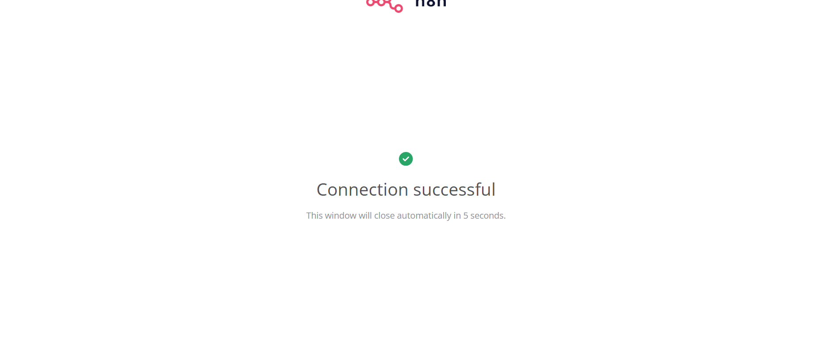

Slide 25
